Slide 1
Inversion of Control
Continuous staff improvement project
Yurii Hohan

Slide 2
Introduction
DRY
KISS
R#
Code Standard
Dependency Inversion
Inversion of Control

Slide 3
The Evils of Duplication
As programmers, we collect, organize, maintain, and harness knowledge. We document knowledge in specifications, we make it come alive in running code, and we use it to provide the checks needed during testing.
Knowledge isn't stable. It changes—often rapidly. Your understanding of a requirement may change.
The problem is that it's easy to duplicate knowledge in the specifications, processes, and programs that we develop, and when we do so, we invite a maintenance nightmare.

Slide 4
DRY - Do not repeat Yourself
Principle: Every piece of knowledge must have a single, unambiguous, authoritative representation within a system.
The alternative is to have the same thing expressed in two or more places. If you change one, you have to remember to change the others.

Slide 5
Imposed Duplication
Sometimes, duplication seems to be forced on us.
Project standards may require documents that contain duplicated information, or documents that duplicate information in the code.
Multiple target platforms each require their own programming languages, libraries, and development environments, which makes us duplicate shared definitions and procedures.
Programming languages themselves require certain structures that duplicate information.
And yet often there are ways of keeping each piece of knowledge in one place, honoring the DRY principle

Slide 6
Other Duplication
Inadvertent Duplication. Sometimes, duplication comes about as the result of mistakes in the design.
Impatient Duplication. Every project has time pressures—forces that can drive the best of us to take shortcuts. Need a routine similar to one you've written? You'll be tempted to copy the original and make a few changes. Need a value to represent the maximum number of points? If I change the header file, the whole project will get rebuilt.
Interdeveloper Duplication. On the other hand, perhaps the hardest type of duplication to detect and handle occurs between different developers on a project. Entire sets of functionality may be inadvertently duplicated, and that duplication could go undetected for years, leading to maintenance problems.

Slide 7
KISS. Keep it simple, stupid
A design principle noted by the U.S. Navy in 1960.
The KISS principle states that most systems work best if they are kept simple rather than made complicated; therefore simplicity should be a key goal in design and unnecessary complexity should be avoided.
Leonardo da Vinci's "Simplicity is the ultimate sophistication",
Mies Van Der Rohe's "Less is more",
Antoine de Saint Exupéry's "It seems that perfection is reached not when there is nothing left to add, but when there is nothing left to take away".
Colin Chapman, the founder of Lotus Cars, urged his designers to "Simplify, then add lightness".

Slide 8
KISS.
“Debugging is twice as hard as writing the code in the first place. Therefore, if you write the code as cleverly as possible, you are, by definition, not smart enough to debug it.” -Brian Kernighan
Donald Knuth “Programmers waste enormous amounts of time thinking about, or worrying about, the speed of noncritical parts of their programs, and these attempts at efficiency actually have a strong negative impact when debugging and maintenance are considered. We should forget about small efficiencies, say about 97% of the time: premature optimization is the root of all evil. Yet we should not pass up our opportunities in that critical 3%”

Slide 9
YAGNI -You aren't gonna need it
"Always implement things when you actually need them, never when you just foresee that you need them.”
"You aren't gonna need it“ is a principle that states a programmer should not add functionality until deemed necessary.
YAGNI is a principle behind the practice of "do the simplest thing that could possibly work" (DTSTTCPW)

Slide 10
YAGNI -You aren't gonna need it
The time spent is taken from adding, testing or improving the necessary functionality.
The new features must be debugged, documented, and supported.
Any new feature imposes constraints on what can be done in the future, so an unnecessary feature may preclude needed features from being added in the future.
Until the feature is actually needed, it is difficult to fully define what it should do and to test it. If the new feature is not properly defined and tested, it may not work correctly, even if it eventually is needed.
It leads to code bloat; the software becomes larger and more complicated.

Slide 11
Resharper
ReSharper extends Visual Studio with over 1700 code inspections for C#, VB.NET, ASP.NET, JavaScript, TypeScript and other technologies. For most inspections, ReSharper provides quick-fixes (light bulbs) to improve code in one way or another.
ReSharper makes Microsoft Visual Studio a much better IDE. .NET developers worldwide wonder how they've ever lived without ReSharper's code inspections, refactorings and navigation.

Slide 12

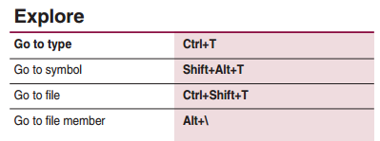


Resharper. Hot Keys

Slide 13
Visual Studio. Shortcuts
Do All Shortcut – Ctrl + . / Alt + Enter
Navigate
Go To All – Ctrl + , / Ctrl + T
Go To Definition – F12 / Ctrl + LMC
Go To Implementation – Ctrl + F12
Locate
Find All References – Shift + F12
Find – Ctrl + F / Ctrl + Shift + F
Find In Solution Explorer – Ctrl + [, S
Edit
Format Document – Ctrl + K, D
Comment/Uncomment – Ctrl + K, C / Ctrl + K, U
Move Line Up/Down – Alt + ↑/ Alt + ↓

Slide 14
Code Standard
Formatting
All indentation is done with 4 spaces. No tabs are used.
Curly braces ({}) should be used around expressions except if the expression is a one-line statement (if guards etc.).
Curly braces should always be the single character existing on the line.
Use space after each comma separator in method calls.
Do not use space after parenthesis and the method argument.
Do not use space between method name and opening parenthesis for the arguments.
CreateFoo(theFooMaker, 0, 1)
Use a space before control statements
Use a space before and after comparison operators
if (x == y)
{
DoThis();
DoThat();
}
Code lines (comments excluded) should not exceed 120 cols.

Slide 15
Code Standard
Naming convention
Private member fields should be prefixed with an underscore
public class MyClass
{
private int _counter;
}
Do not use Hungarian notation
Use same naming convention for constants as with non-constants. Consider using readonly members or a read-only properties over field constants.
Use PascalCasing to non-private member fields. Non-private fields should generally be avoided
Use camelCasing for parameters
Use camelCasing for local variables
Use PascalCasing to methods, classes, properties, enums etc.
Use I as prefix for interfaces
All classes, variables etc. should have self describing and English name.

Slide 16
Code Standard
Best Practices
Following items are recommendations for how to structure and design the code
It is generally better to use interfaces instead of inheritance to model relationship between classes.
Consider to refactor a method into several methods that contains more than 15-20 code lines.
Methods should be short, concise and preferably only do one thing but do that thing well (quote from Linus Torvalds).
If you use a specific pattern you are encouraged to refer to the pattern in comments so it is easier for others to understand your code.

Slide 17
Code Standard
Usage of the var keyword
Var may be used if the right statement clearly shows which type that the variable represents.
var dbConnection = new System.Data.Common.DbConnection();
Do not use var if the right statement doesn't show which type the variable is.
//Do not use below
//var dbConnection = Helper.GetDbConnection();
//Use below instead
IDbConnection dbConnection = Helper.GetDbConnection();

Slide 18
The Dependency Inversion Principle
HIGH LEVEL MODULES SHOULD NOT DEPEND UPON LOW LEVEL MODULES. BOTH SHOULD DEPEND UPON ABSTRACTIONS.
ABSTRACTIONS SHOULD NOT DEPEND UPON DETAILS. DETAILS SHOULD DEPEND UPON ABSTRACTIONS.
Why the word “inversion”? It is because more traditional software development methods, such as Structured Analysis and Design, tend to create software structures in which high level modules depend upon low level modules, and in which abstractions depend upon details.

Slide 19
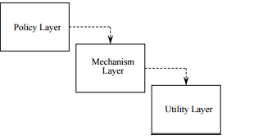
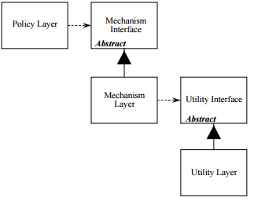
The Dependency Inversion Principle

Slide 20

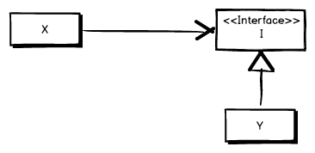
The Dependency Inversion Principle

Slide 21
Benefits of Inversion of Dependency
X is not dependent on Y anymore and it’s therefore less likely that we’ll have to make changes to X when we make changes in Y.
Furthermore X is now much more flexible as we can change which implementation of Y it uses without changing anything in X.
Benefit of inversion of control is also that we can isolate our code when creating unit tests.
We want to be able to test the logic in X without having to care about the component Y.

Slide 22
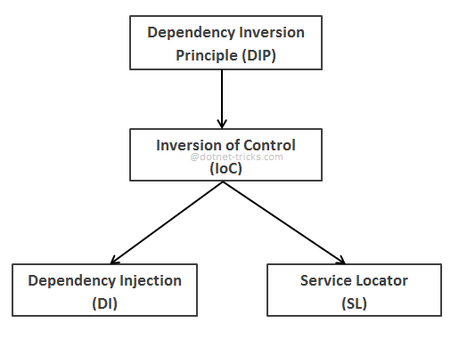
Building Blocks

Slide 23
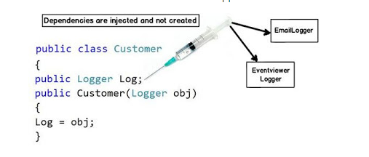
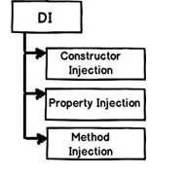
Dependency Injection

Slide 24
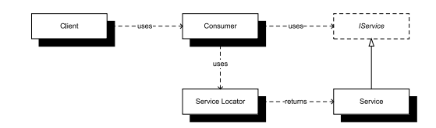
Service locator

Slide 25
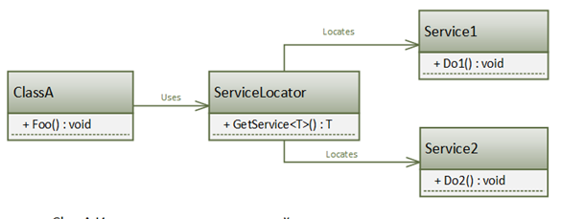
Service locator

Slide 26
Service locator
Provide a global point of access to a service without coupling users to the concrete class that implements it.
A service class defines an abstract interface to a set of operations. A concrete service provider implements this interface. A separate service locator provides access to the service by finding an appropriate provider while hiding both the provider’s concrete type and the process used to locate it.

Slide 27
Service locator
Provide a global point of access to a service without coupling users to the concrete class that implements it.
A service class defines an abstract interface to a set of operations. A concrete service provider implements this interface. A separate service locator provides access to the service by finding an appropriate provider while hiding both the provider’s concrete type and the process used to locate it.

Slide 28
Assignment
Learn Visual Studio ShortCuts
Implement Inversion of control in Your Project.

